Slide 1

Capstone Project: a/b test
Application process testing for musclehub
Nikola Andric

Slide 2
Problem statement
MuscleHub is a new gym which has run an A/B test with a fitness test. Group B skips the fitness test and go straight to fill out an application
The application for group A process if as follows
Taking a fitness test with a personal trailer
Filling out an application for the gym
Sending the payment for the membership
The goal is to answer the question whether the fitness test affects the membership rates, and if so what is the trend.

Slide 3
Available Data
The data made available for this study can be split in two main categories:
Qualitative Data: Several interviews with some of the applicants. Due to a small sample of only 4 interviews available, and contradicting data (some of the interviewees are very fond of the fitness test whilst others find it to intense and it was a deciding factor in their choice decline the membership) a qualitative analysis will be of a smaller significance for this study.
Quantitative Data: A database for 5004 members containing their names, dates of visit, fitness test, application, membership purchase, which group they belonged to and whether they have filled out an application and whether they are currently members. This database serves as a main source for the analysis.
Chi-square test
Analyses whether the difference between two sets of data can be ascribed to chance, or whether there is a correlation between them
Tests data in different categories (whether they applied, or whether they purchased a membership)

Slide 4
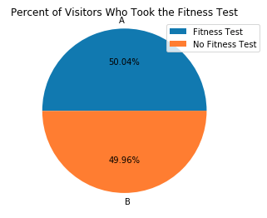
The tests
3 different hypotheses tests were run:
Percent of visitors who fill out an application
Percent of applicants who purchase a membership
Percent of visitors who purchase a membership
For each of the group a comparison was made between the visitors who take a fitness test, and the visitors who don‘t.

Slide 5
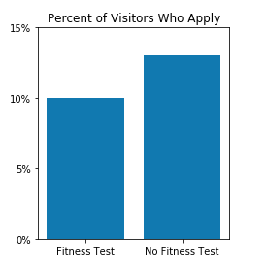
Result 1: Visitors-Application
A higher number of people apply, when they are not subjected to the fitness test.
The chi-squared test returns a p-value of 0,0009 which implies a statstical significance (i.e. There is a very low chance that it is random chance at work)

Slide 6
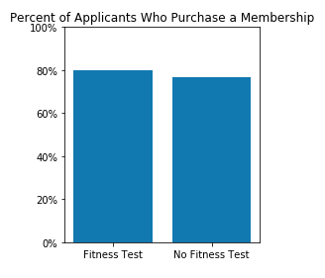
Result 2 Applications-Membership
Applicants who were subjected to a fitness test were more likely to purchase a membership than the ones who did not do the test.
The chi-squared test returns a p-value of 0,43 which implies a high chance that this result is due to chance/a small sample. It is not of statistical relevance.

Slide 7
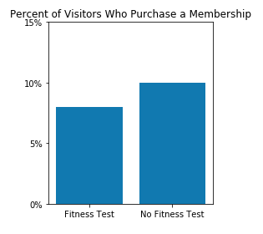
Result 3: Visitors-membership
Visitors who were subjected to a fitness test seem to have a lower probability of purchasing a membership than the visitors who were not subjected to one.
The Chi-Square test returns a value of 0,014 which implies a high statistical significance

Slide 8
Conclusion and recommendations
The quantitative data implies that MuscleHub should implement the plan of allowing applications without a fitness test. Our analysis has found a strong correlation between not offering the fitness test and new membership, with a high statistical significance
The quantitative data, albeit being the basis for this study, does not offer any information on the gender or age of visitors, applicants or members. By expanding the database with the afore-mentioned information we would gain valuable insight.
The qualitative data as offered us some case-specifics, but since there were only four interviews listed, compared to over five thousand in the database, we can not draw any conclusions from it.

